Slide 1
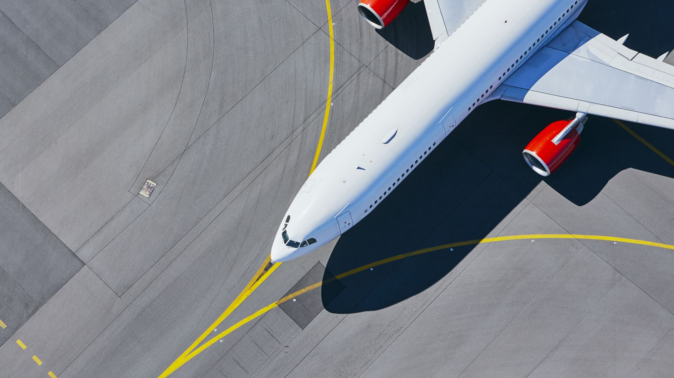

Covid 19 Impact on US Airline Industry
Group 6
Ava Lee
Christophe Guenther
Jed Murphy
Silas Phillips
GITHUB URL-https://github.com/silas-ph/Group_6_EDA

Slide 2
Challenges and Problem
Storage issues with GitHub. This resulted in hours spent finding what turned out to be a simple solution. Buy more storage!!!
Due to their size, some of us were unable to download the data files to their local machines. We tried to resolve the issue by CoLab machine. However, processing the large data files required almost 6GB of RAM too much for an instance of a free CoLab machine
Airline dataset specifics are not available unless we wanted to pay. The airfare data was corrupt and had to be manually converted to .csv files

Slide 3
Goals and questions
1. How did domestic U.S. air passenger traffic change during Covid-19?
2. How long did it take for passenger volume to normalize to pre-pandemic levels after Covid 19?
3. How did the average airfare change during Covid?
4. Can we discern any changes between air passenger traffic before and after Covid-19?
We are only making decisions based on our data.

Slide 4

EDA Methods and Techniques used for this report
Download and import files
Run basic EDA glob, for loops, dropna, isnull, drop duplicates
Merge and combine the files into different DataFrames for analysis
consistency check consists of summing the flight data by month, year, and destination airport
Process the data from the separate DataFrames into a summary DataFram
Data exploration led us to define the following time periods. Before Covid-19, During Covid-19 and after Covid-19

Slide 5

Results of are analysis
Flight data

Slide 6
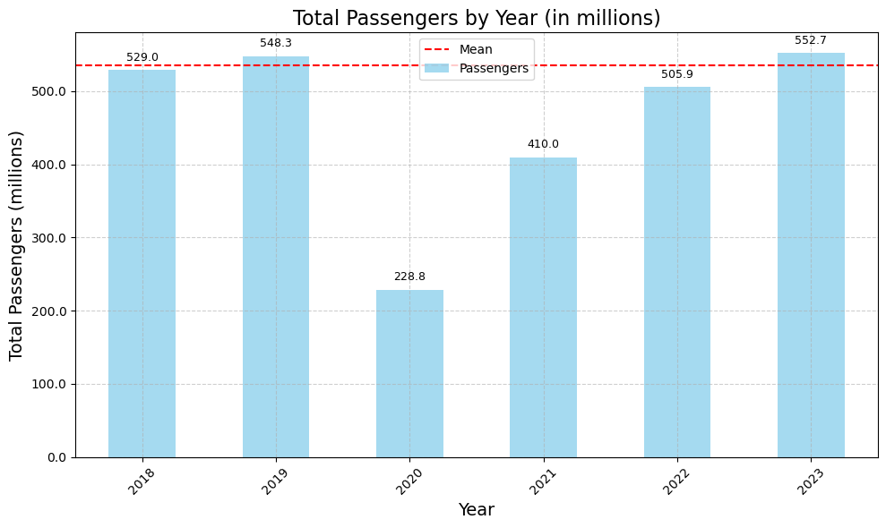
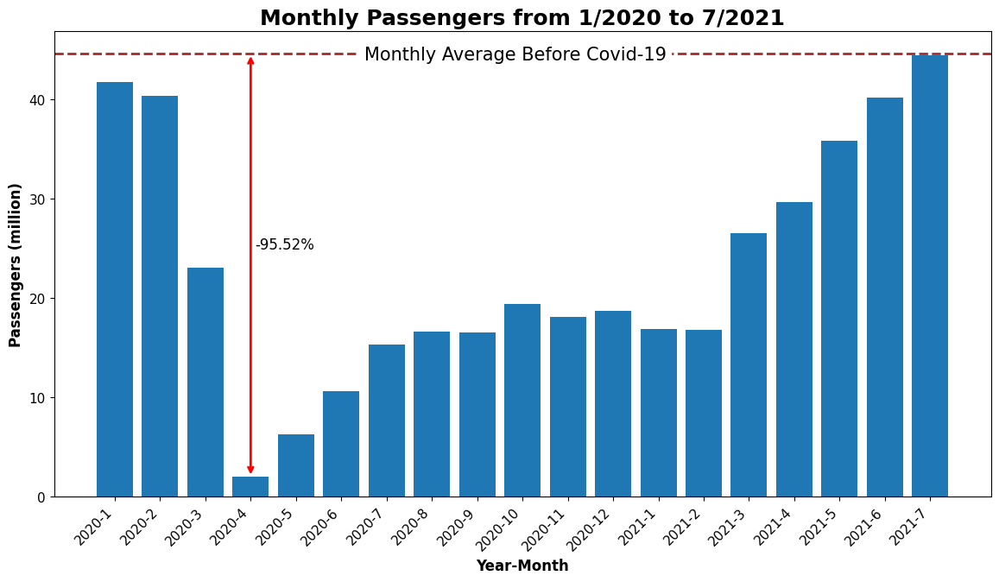

Question 1: How did U.S. air passenger traffic change during Covid-19?
The total passenger traffic dropped 319.5 million
In 2019 from the previous year.
total number of passengers flying on U.S. airlines from the major airports plummeted from 41.75 million in January 2020 to a mere 2.0 million in April 2020 – a staggering 95.2% decline in just three months.

Slide 7
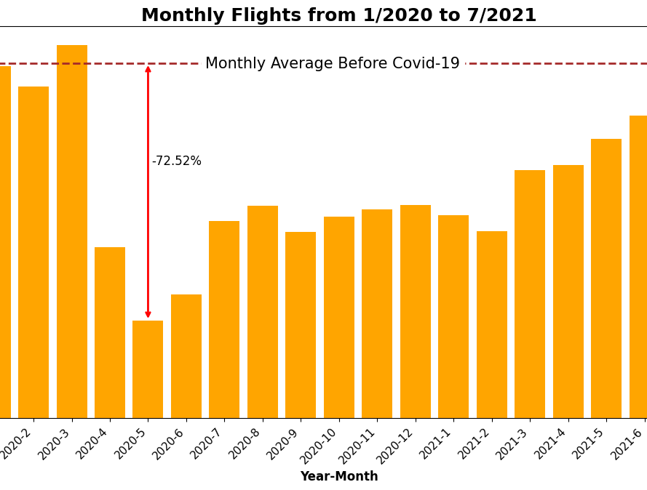
Monthly passengers
The number of flights dropped by 75.52% as compared to its average before Covid

Slide 8
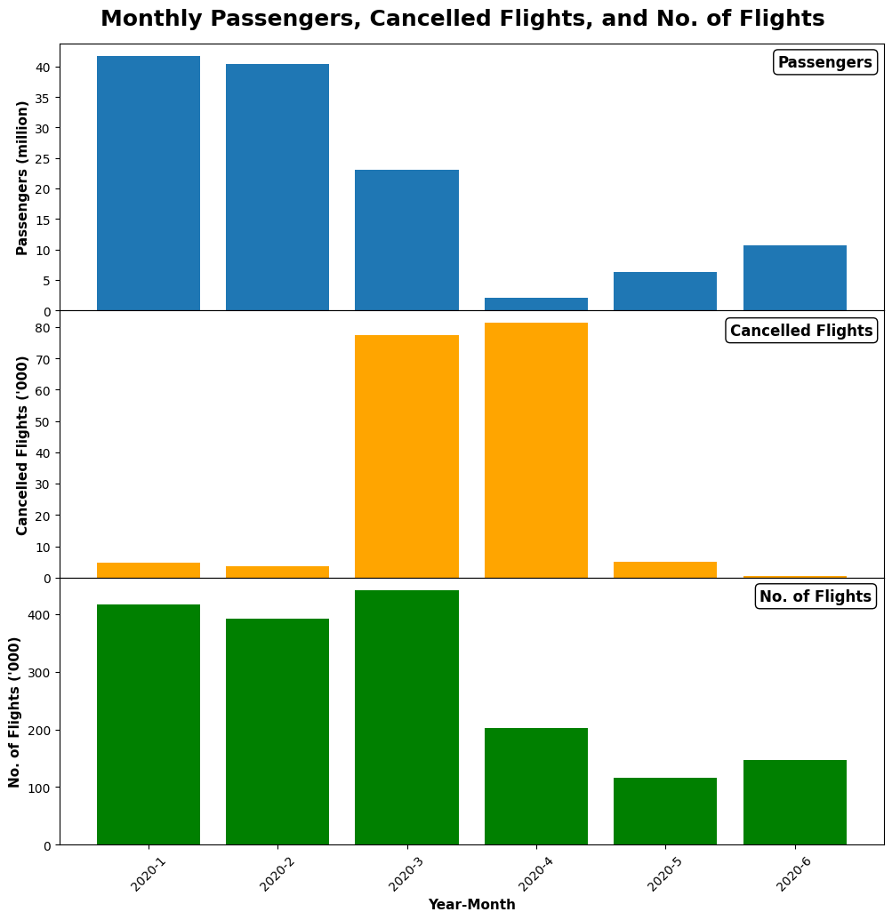
Canceled Flights
Cancellation rate for U.S. domestic flights reached 41.57% in April 2020, compared to just 2.31% in April 2019.
As the number of flights declined, the cancellation rate gradually decreased. In December 2020, the domestic flight cancellation rate was 1.24%, commensurate with the 1.01% cancellation rate recorded in December 2019.

Slide 9
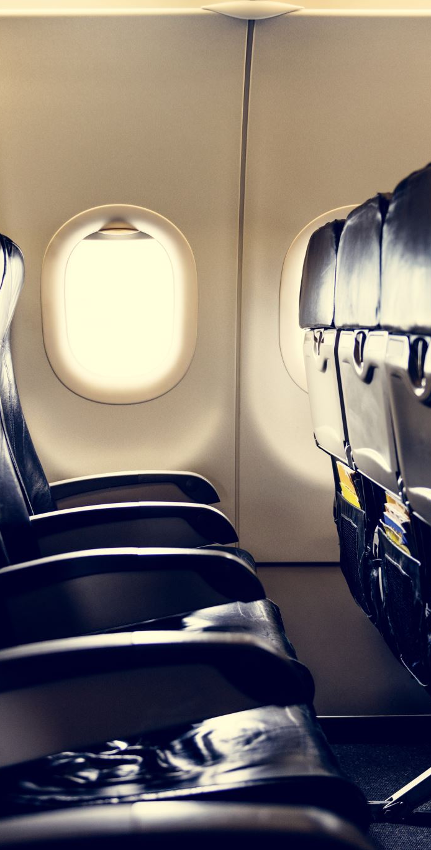
Question 2: How long did it take for passenger volume to normalize to pre-pandemic levels after Covid-19
As is apparent from the “Monthly Passengers from 1/2020 to 7/2021” plot, passenger volume gradually increased from its April 2020 low, but it took until July of 2021 for it to reach its average before Covid-19.
We used this plot to define the Covid-19 period as starting in March 2020, the first month with a sizeable decline in passenger traffic until July 2021 when passenger volume had recovered to the monthly average before Covid-19.

Slide 10
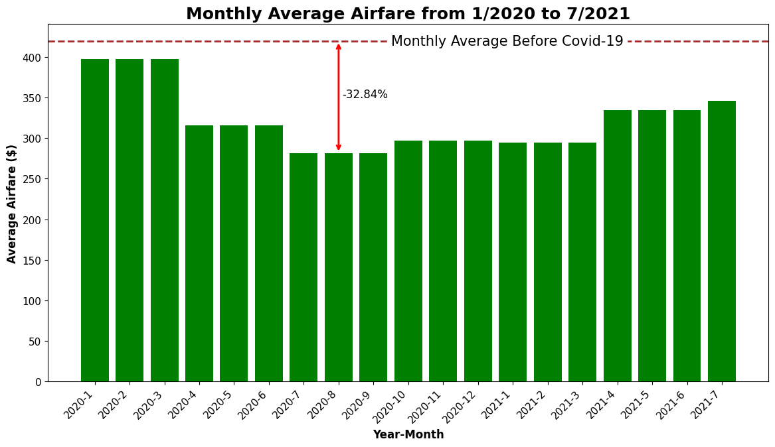
Question 3: How did the average airfare change during Covid?
(inflation adjusted to quarter 3 of 2023) during the Covid-19 period.
Average air faire declined by 32.84% as compared to its average before Covid-19.

Slide 11
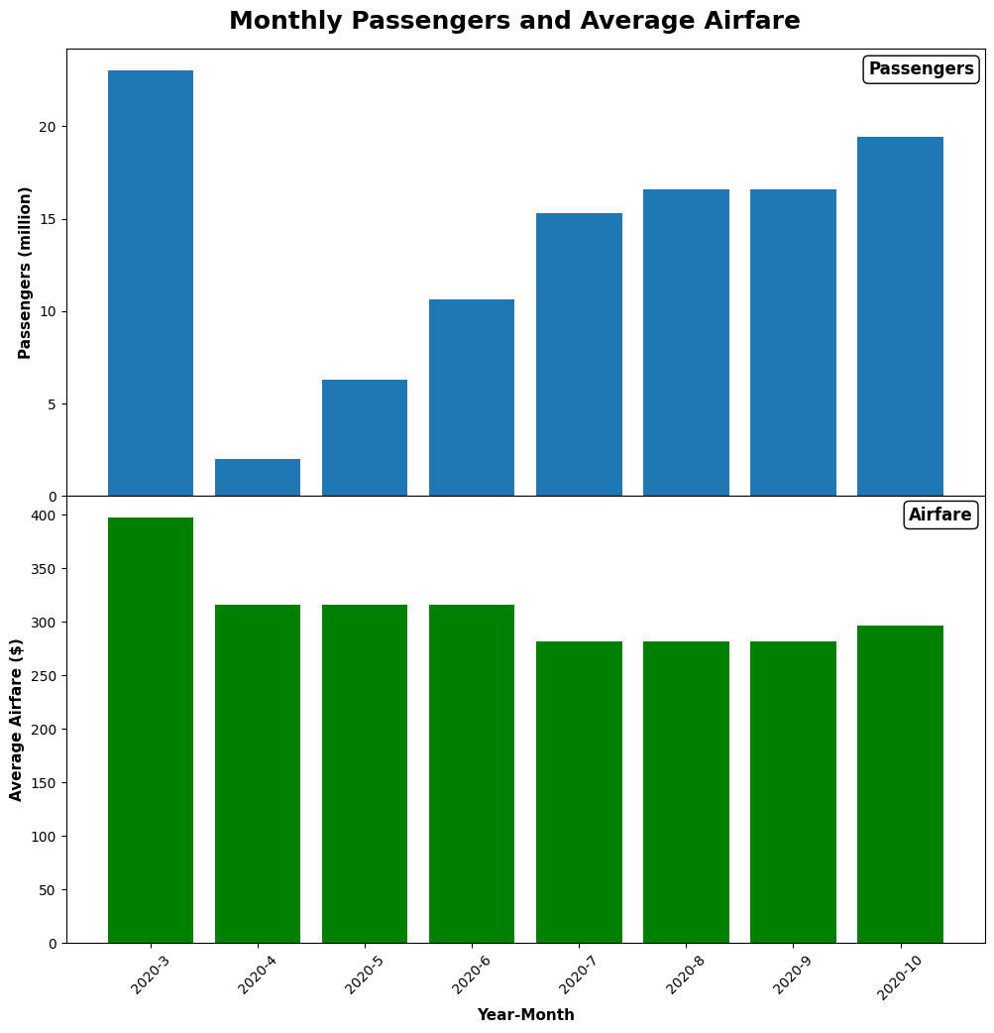

Note that the airfare reached its minimum about three months after the passenger volume reached its lowest point. This can be seen more clearly in this plot.

Slide 12
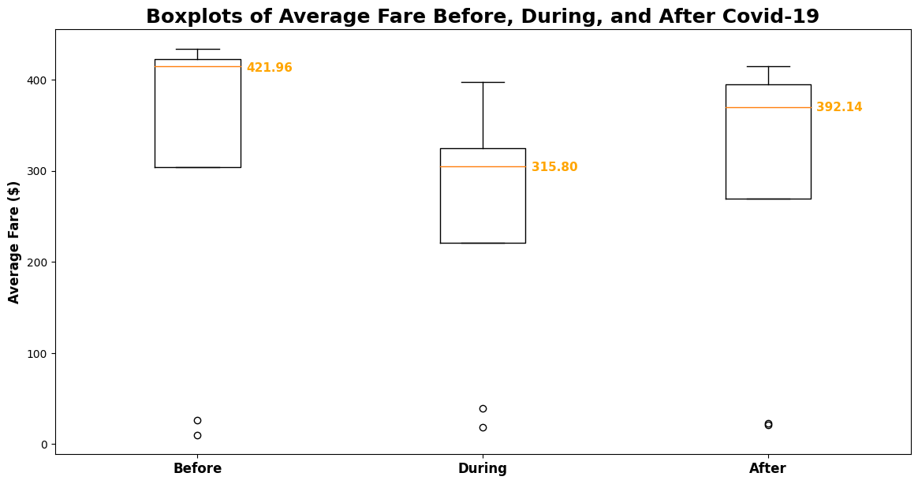
Question 4: Can we discern any changes between air passenger traffic before and after Covid-19?
Impact on Airfare: As can be seen from this plot the median airfare (inflation adjusted to quarter 3 2023 levels) for the period after Covid (defined from August of 2021 to September of 2023) is still almost 10% lower than the median before Covid-19 with an expected drop during Covid-19.
What were the impacts on? Airfare, Arrival delays, Passengers per flight

Slide 13
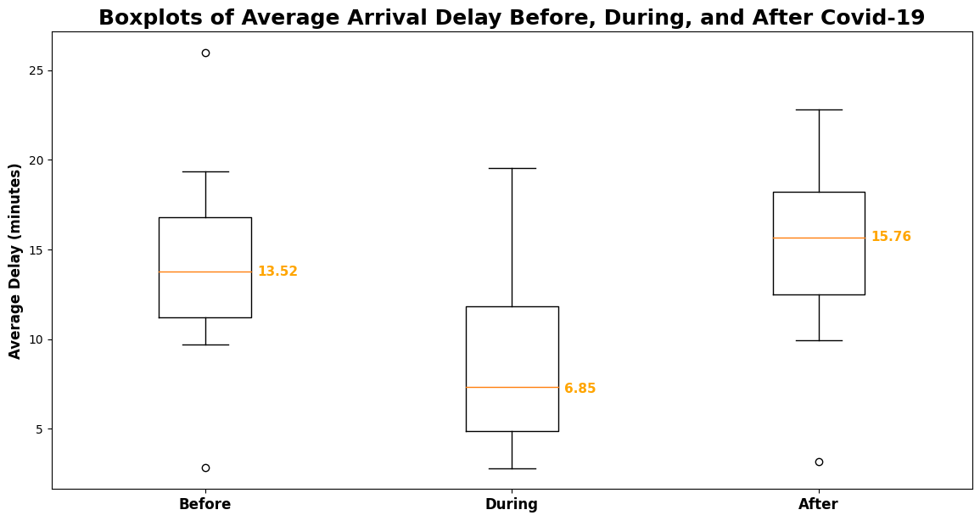
What were the impacts on arrival delays?
The median arrival delay dropped considerably during Covid-19 but as of the end of 2023 was over two minutes larger than its pre-pandemic level.
The reason for the drop in arrival delays during Covid-19 might be due to the reduced passenger volume allowing airline personnel more time to make sure flights were on time.

Slide 14
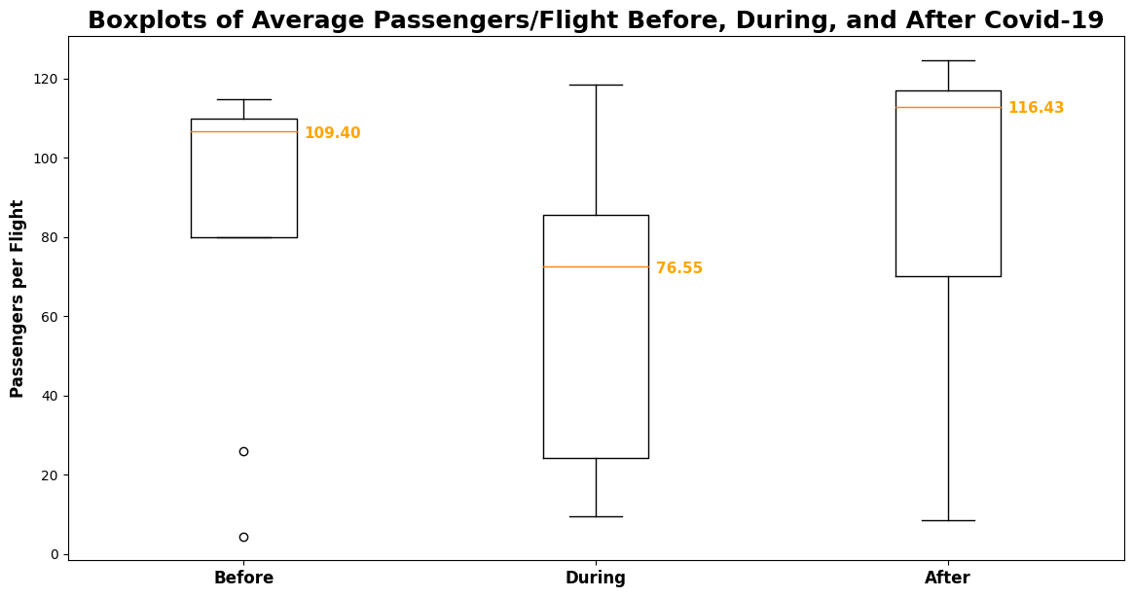
What were the impacts on Passengers per flight?
The median for the number of passengers per flight after Covid-19 is considerably higher than before Covid-19. That makes sense since passenger volume seems to have recovered (close to) pre-pandemic levels, however, the number of flights is still lower than it was pre-pandemic. This might also explain the increase in arrival delays since it might take more time to process more passengers per flight increasing the likelihood of delays.

Slide 15
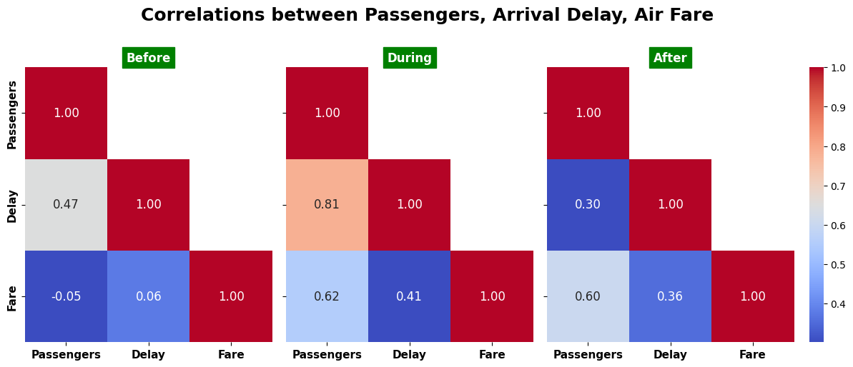
Other Results comparing the correlations between passenger volume, airfare, and arrival delays for the periods before Covid-19, during Covid-19, and after Covid-19, see the following plot.
Before Covid, there was practically no correlation between passenger volume and airfare. That changed to a moderately strong positive correlation during Covid-19. This might make sense because as passenger volumes gradually increased to pre-pandemic levels, the airlines were able to raise their prices as well. Note, however, that this moderately strong positive correlation has persisted after Covid-19, although passenger volume increased much more slowly. Further investigation is needed to understand this observation.
A further observation is that the positive correlation between passenger volume and delay increased considerably during Covid-19, although the size of the average delay decreased considerably. Again, further analysis is necessary to better understand this observation.

Slide 16

Conclusion
Key Points:
Passenger volume decreased by 95.5% at the lowest point compared to the pre-pandemic average.
The number of flights decreased by 75.5% from the pre-pandemic average.
Airfare decreased by 32.8% during the pandemic.
Cancelled flights increased significantly in the first months of Covid-19.

Slide 17
Observations:
Airlines initially reacted by cancelling flights before reducing the number of flights.
Airfares reached their minimum about three months after passenger volume reached its lowest point.
The decline in airfares was less severe than the decline in passenger volume or the number of flights.

Slide 18

Topics for further investigation
What explains the difference in decline between passenger volumes, number of flights, and average airfare?
What is the exact month when the airfare reached its minimum?
Why did it take three months for airfare to reach its minimum as compared to passenger volume?
Why did it take longer for the number of flights to reach pre-pandemic levels as compared to the passenger volume?
Why is the median average airfare still lower than before Covid-19 (in inflation adjusted dollars)?
Why has the correlation between passenger volume and airfare we observed during Covid-19 persisted after Covid-19?
Why did the correlation between passenger volume and arrival delay increase during Covid, while at the same time the average arrival delay decreased?
Did Covid-19 have any effect on seasonality?
How did air traffic patterns vary by airport, city, and state? Was there any correlation between Covid-19 restrictions and air traffic patterns?

Slide 19
Recovery:
Post-Pandemic Changes:
Passenger volume recovered to pre-pandemic levels by July 2021.
The number of flights and airfare remained lower than pre-pandemic averages.
Median airfare has not yet reached pre-pandemic levels.
Average arrival delay has increased compared to pre-pandemic levels.
The number of passengers per flight has increased.
Potential reasons for increased delays:
More passengers per airplane due to reduced flights.
Possible staff reductions during the pandemic.
Lingering Effects:
Median airfare remains lower than pre-pandemic levels.
Arrival delays are higher than before Covid-19.
The number of passengers per flight is higher than pre-pandemic levels.
The correlation between passenger volume and airfare is similar to that during Covid-19.

Slide 20
SOURCES
The data used for the report falls under the Freedom of Information act. United States. Department of Transportation. (2022). Managing Rights. https://doi.org/10.21949/1520564
Flight Data Dataset Title: Marketing Carrier On-Time Performance (Beginning January 2018) U.S. Department of Transportation, Department of Transportation Statistics URL: https://www.transtats.bts.gov/DL_SelectFields.aspx?gnoyr_VQ=FGK&QO_fu146_anzr=b0-gvzr Dates Accessed: 4/8/2024 - 4/17/2024. Other Details: Data retrieved from January 2024 to December 2023 as monthly ‘.csv’ files.
Passenger Data Dataset Title: Passengers All Carriers – All Airports U.S. Department of Transportation, Department of Transportation Statistics URL: https://www.transtats.bts.gov/Data_Elements.aspx?Data=2
Air Fare Data by Quarter Dataset Title: Passengers All Carriers – All Airports U.S. Department of Transportation, Department of Transportation Statistics URL: https://www.transtats.bts.gov/AverageFare/
Dates Accessed: 4/10/2024 - 4/13/2024- 4/18/2024 Other Details: Airfare price data by quarter, each quarter is a separate file
Dates Accessed: 4/8/2024 - 4/17/2024. Other Details: Select “U.S. Carriers” and each major airport from the dropdowns and retrieve a ‘.csv’ file for every major airport. Data from October 2002 through December of 2023.

Slide 21
Additional resources used
Using Python glob function:
https://www.geeksforgeeks.org/how-to-use-glob-function-to-find-files-recursively-in-python/
Visualizations:
https://matplotlib.org/stable/gallery/lines_bars_and_markers/barchart.html#sphx-glr-gallery-lines-bars-and-markers-barchart-py
https://matplotlib.org/stable/api/axes_api.html#module-matplotlib.axes
To fix correlation matrix: Seaborn heat map doesn't display annotations for all rows #14363, https://github.com/microsoft/vscode-jupyter/issues/14363, accessed on 4/17/2024
https://matplotlib.org/stable/gallery/lines_bars_and_markers/barchart.html#sphx-glr-gallery-lines-bars-and-markers-barchart-py
https://matplotlib.org/stable/api/axes_api.html#module-matplotlib.axes
https://medium.com/
Stackoverflow.com
www.python.org
Replicate columns
https://www.statology.org/pandas-replicate-rows/

